Slide 1
Commissioning Lowband HERA Data to Measure Instrument Sensitivity
Shane Bechtel
Arizona State University
April 13th, 2019
HERA Antennas
Kathryn Rosie

Slide 2
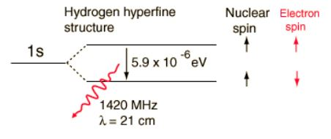
Cosmic Timeline
Image Credit: https://commons.wikimedia.org/wiki/File:CMBTimeline300noWMAP.jpg
Image Credit: http://hyperphysics.phy-astr.gsu.edu/hbase/quantum/h21.html
Notes:
What to know for:
What to know from:
- History of the universe
Difficulties Observing Dark Ages to EoR (Neutral Hydrogen)
Spin Flip
Form of light when photon arrives at Earth

Slide 3
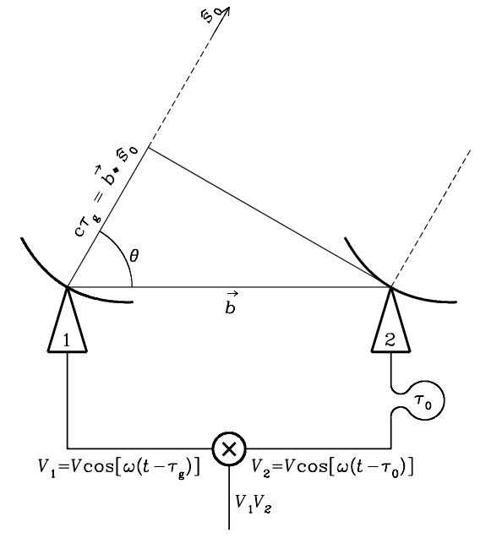
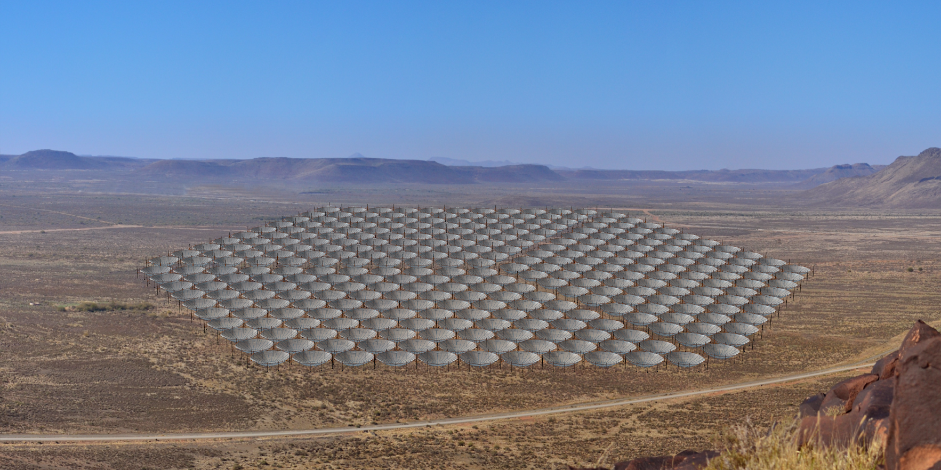
HERA Radio Telescope
Simulated Image of Full HERA Array
Image Credit: “Hydrogen Epoch of Reionization Array”, DeBoer, D. et al
Image Credit: Condon, J.J. and Ransom, S.M., _Essential Radio Astronomy_, 2016
Notes:
Need to know from:
Basic HERA Information (South African Karoo Desert, 350 antennas)
HERA Bandwidth, specifically new receivers
Touch on compactness
Reintroduce Horizon limit, touch on baseline length importance
Speak a bit on spectral leakage then transition to next slide

Slide 4
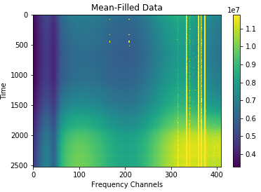
Commissioning Lowband Data
Before analysis began, well-behaved data was required
Initial data releases contained many systematic issues
HERA Commissioning team needed assistance investigating each data set as it was released
Notes:
Need to know from:
New receiver data was very sketchy at first
Much time was spent trying to assist commissioning team
Explain issue with plot shown

Slide 5
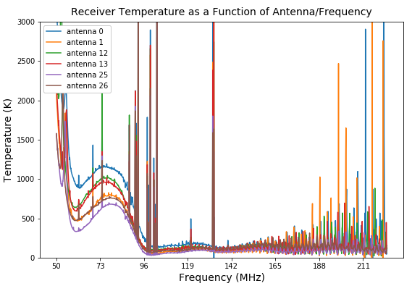
Measuring the Receiver Temperature
$$T_{data}\left(LST\right)=A_{0}×\left(T_{sky}\left(LST\right)−mean\left(T_{sky}\right)\right)+R_{0}$$
$$A_{0}:Power Gain Parameter$$
$$R_{0}:Noise Parameter$$
$$T_{rxr}=\frac{R_{0}}{A_{0}} −mean(T_{sky})$$

Slide 6
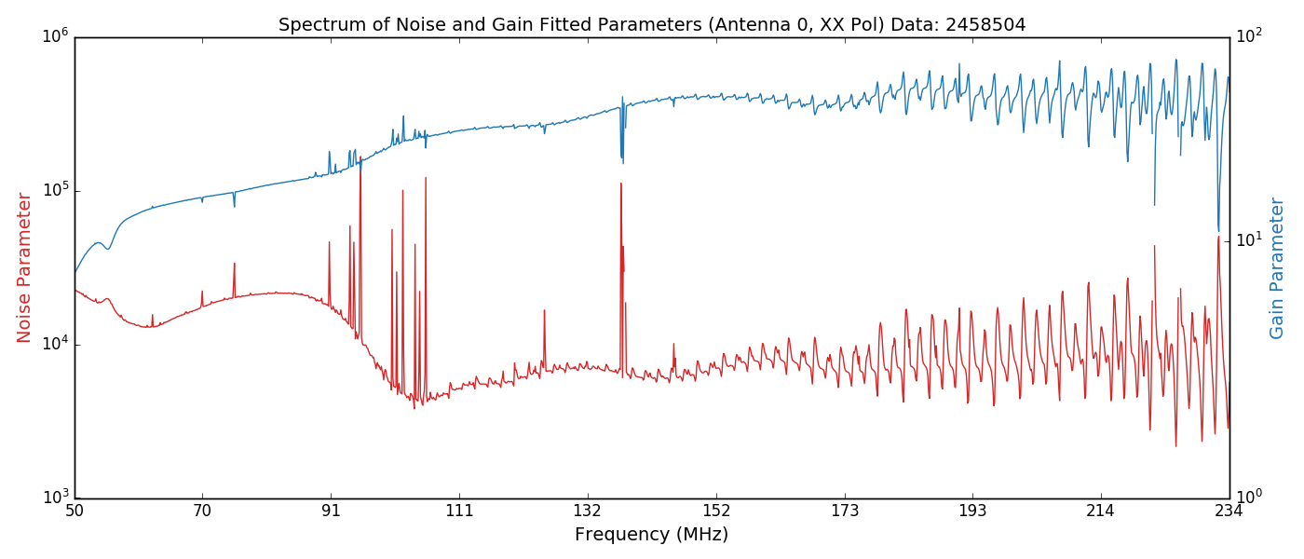
Noise and Gain Fit Parameters

Slide 7
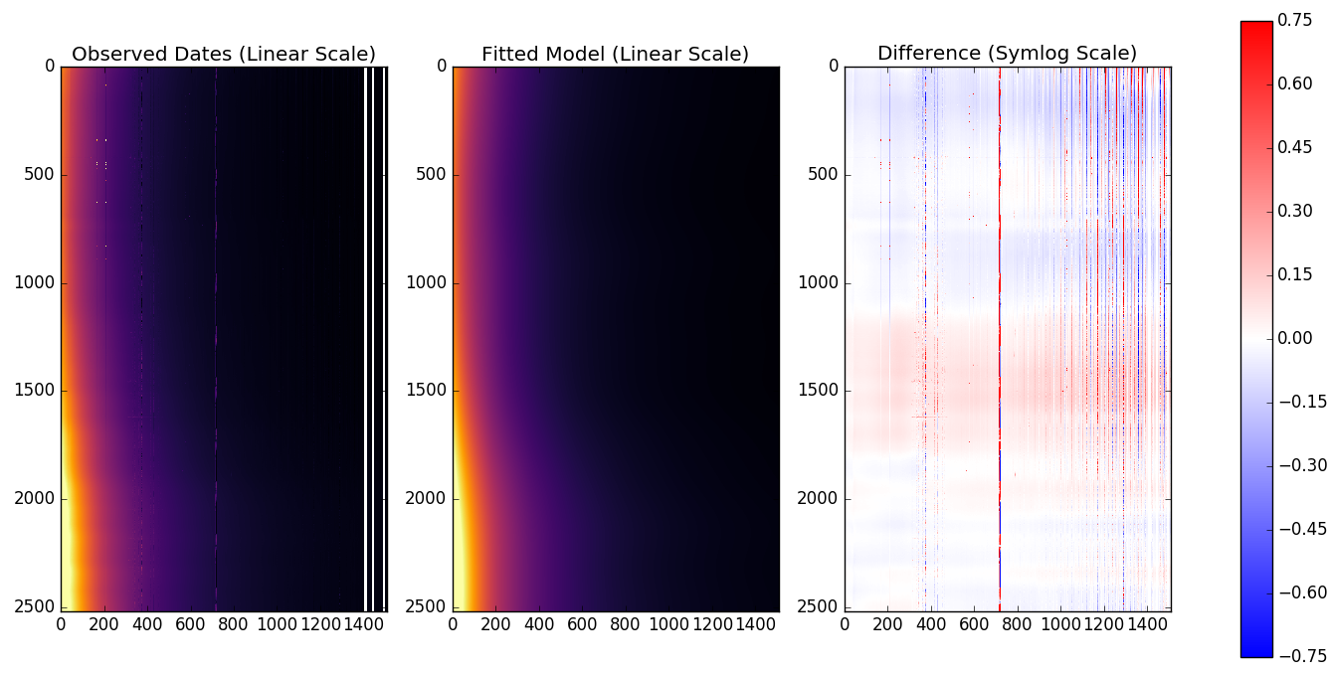
Goodness of Fit?
Time
Frequency (50-250 MHz)

Slide 8
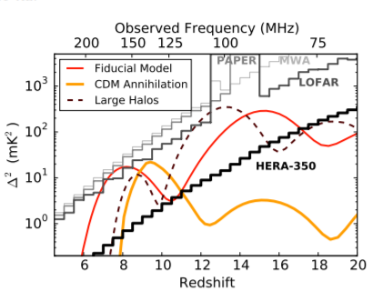
Summary
The receiver temperature is notably large in the new lower bandwidth frequencies.
The agreement between the data and model indicates the cause of this may be due to a poor sky model or antenna beam at these frequencies.
Moving forward: the next steps will be to investigate the two potential sources mentioned. If both are working properly, then move forward with these temperature to measure sensitivity.
Questions?
Email: skbechte@asu.edu
Image Credit: “Hydrogen Epoch of Reionization Array”, DeBoer, D. et al
Notes:
Need to know from:
New receiver data was very sketchy at first
Much time was spent trying to assist commissioning team
Explain issue with plot shown

Slide 9
Acknowledgements
The Hydrogen Epoch of Reionization Array is hosted by the South African Radio Astronomy Observatory, which is a facility of the National Research Foundation, an agency of the Department of Science and Technology.
This material is based upon work supported by the National Science Foundation under Grant No. 1636646, the Gordon and Betty Moore Foundation, and institutional support from the HERA collaboration partners.
Notes:
Need to know from:
New receiver data was very sketchy at first
Much time was spent trying to assist commissioning team
Explain issue with plot shown

Slide 10
Summary
The receiver temperature is notably large in the new lower bandwidth frequencies.
The agreement between the data and model indicates the cause of this may be due to a poor sky model or antenna beam at these frequencies.
Moving forward: the next steps will be to investigate the two potential sources mentioned. If both are working properly, then move forward with these temperature to measure sensitivity.
Questions?
Email: skbechte@asu.edu
Image Credit: “Hydrogen Epoch of Reionization Array”, DeBoer, D. et al
Notes:
Need to know from:
New receiver data was very sketchy at first
Much time was spent trying to assist commissioning team
Explain issue with plot shown

